Slide 1


Overview of a Niger Delta Model: A Presentation of the Case Study and Features Cross River State Growth and Development Strategy (GDS) Process
A Presentation to the Niger Delta Development Forum (NDDF)
by
Prof. A. E. Oguntade
Federal University of Technology Akure

Slide 2

Contents
Overview of Development Planning (framework, long vrs short term planning, Planning at Su-national level, etc)
Framework – Lagos, Kaduna, Ondo, SDP; Vision 2020
Cross River Growth and Development Strategy
The Assignment - Objectives
The Assignment – Work Programme for GDS
Work Programme for Diagnostic Review
Communication Strategy
Structure of the GDS Report
Some FAQS

Slide 3
Development : What does it mean?
Development is a concept difficult to define to the satisfaction of everybody
It is complex, ambiguous and contentious
Perspectives to development could be historical and policy related
  Historical perspective is long term and relatively value free
    It sees development as a process of change
  Policy perspective is evaluative or indicator led
    It is based on value judgments, and has short- to medium-term time horizons
    It sets targets to be met at different points in time for example, the Sustainable Development Goals

Slide 4
Development : What does it mean?
Development concerns well-being of human beings
Different perspectives of development given prominence at different times:
  mass unemployment which is usually the case in times of economic depression
  income gaps between the rich and the poor
  income distribution within nations
  poverty, hunger and socio-economic wellbeing
  economic growth and national income per capita as measures of development

Slide 5
Development : What does it mean?
Currently economic growth is taken to be a means while human development is the end
Additionally, sustainable development is emphasized as opposed to unqualified growth or development
Sustainable development addresses equity between generations - inter- and intra-generation
Inter-generational equity - use of available resources by present generation should not compromise the access of the future generations to the same resources
Intra-generational equity - access to available resources and/or well being by people in all strata of the society within the same generation

Slide 6
Development : What does it mean?
Sustainability issues can be categorized into economic, environmental and social
Economic sustainability addresses changes in the total capital stock over time.
Environmental sustainability is concerned with life support systems required for survival of present and future generations
Social sustainability addresses relationships between individuals and groups in the society in regard to participation, togetherness, empathy, honesty, etc
Without economic and environmental sustainability, social sustainability cannot be guaranteed

Slide 7
Development Planning: An Intro
Development planning – (strategic planning)
the process of determining :
  where a nation is going - what it wants to be in the future and
  how it intends to get there
A well-prepared development plan can be useful in:
  saving time, and eliminating the duplication of efforts proper coordination of constituents of the state
  providing a frame of reference for decisions on resource allocation; and
  creating a basis for measuring performance

Slide 8
Development Planning: An Intro
A development plan provides opportunity to
  control the state’s destiny
  seize on unforeseen advantages
  be more prepared to react to negative events or changes in a more controlled way
  plan for change
  change the current ways of doing things within the state
Development planning entails:
  predetermined action towards achieving specific developmental goals
  direction and control towards achieving plan targets

Slide 9
Development Planning: An Intro
A development plan is used to:
  provide overall direction and policy goals towards which MDAs can direct their sector plans and against which these plans can be evaluated to ensure their contribution to overall goal policy
    publicize to public the direction in which the State Government intends to advance development over the coming few years and beyond

Slide 10
Development Planning: An Intro
Relationship between different plans:
Long and Medium Term Policy Documents – State Devt Plan
Outlines overall State Policy Outcomes Loosely costed if possible to demonstrate general realism
Sector Development Plan – 5 to 10 years
Links policy to strategy, generally costed but may include funding gaps
Medium Term Sector Strategy – 3 years – No funding gaps
Consistent with the Sector Plan, all activities costed within projected ceilings
Annual Budget
Based on the first year of the most recent rolling MTSS
Annual Operational Plan
Defines responsibilities for implementation in relation to the budget
Departmental Cash Flow Projections
Quarterly projections of cash requirements against all planned activities

Slide 11
Development Planning: An Intro
People are not comfortable with change
Therefore, development planning should be inclusive – carry most people along
The process must be logical and carefully thought-out
Development planning is both a political exercise as well as a logical, rational process
To ensure wide ownership of the plan and support for its implementation:
  All elements of the economy, and many individuals, should have some input into it
  The views of the people should be obtained
  The sponsorship of the leadership and other key personalities of the state should be visible

Slide 12
Development Planning: An Intro
Why we must plan
  Habakkuk 2:2 indicates the importance of planning; it states:
  Write the vision (the picture of what you want achieve), make it plain upon tables (books, posters, billboards), that he may run that readeth it
  Making it plain means: ensure it is clearly spelt out, easy to read and understandable; no ambiguity
  He may run that readeth it means: anybody that reads it is under compulsion / propelled to run with to implement it

Slide 13
Development Planning: An Intro
Successful implementation of a good plan will result in:
  Shift from traditional low output technologies to science-based high output technologies
  Shift at the household level from subsistence production to specialization and commercialized production activities
  Increased importance of output and input markets and market linkages.
  Substitution of capital for labour, that is, increased mechanization and automation

Slide 14
Development Planning: An Intro
Successful implementation of a good plan will result in:
  Increase in average enterprise size and output as more efficient producers specialize and expand production
  Declining real prices of household consumables, especially food as supplies are increased
  Increasing average household income despite price decline due to increased productivity

Slide 15
Development Planning: An Intro
Successful implementation of a good plan will result in:
  Increase in average enterprise size and output as more efficient producers specialize and expand production
  Declining real prices of household consumables, especially food as supplies are increased
  Increasing average household income despite price decline due to increased productivity

Slide 16
Development Planning: An Intro
Successful implementation of a good plan will result in:
  Decline in the share of the workforce employed in agriculture
  Decline in the share of agricultural GDP as a proportion of overall GDP

Slide 17
Development Planning: An Intro
Enabling conditions for successful implementation of a good plan:
  Effective research and technological development efforts
  Effective agricultural (technological) extension services
  Efficient market channels for selling output
  Efficient input markets to deliver inputs to agriculture and industries
  Value-added (agricultural and industrial) raw material processing enterprises

Slide 18
Development Planning: An Intro
Enabling conditions for successful implementation of a good plan:
  Land tenure system that allows adequate access to land for farming and industrial uses
  Affordable finance for production and marketing agricultural and industrial products
  Low barriers to trade
  Supportive legal framework
  Adequate and efficient public infrastructure

Slide 19
Development Planning: An Intro
Enabling conditions for successful implementation of a good plan:
  Given the political system and the responsibilities of the three tiers of government as entrenched in the constitution, there is a need for a significant level of cooperation among tiers of government in Nigeria in order to put the enabling conditions in place

Slide 20
Objectives of CRS GDS
CRS sets out to develop a 30-year growth and development strategic (GDS) plan to leverage on its areas of competitiveness in delivering inclusive governance and sustainability to its people
The sustainability considerations are to be consistent with the UN-SDGs and CUSO’s Greener Economy; Greener Jobs (GEGJ) Concepts
The assignment is to develop and/or validate available baseline sector reports and co-develop a comprehensive GDS strategic plan including policies for CRS for the period 2015 – 2045

Slide 21
Objectives of CRS GDS
Specific Objectives:
Assess and analyze the State’s priorities over years
  wrt gender and environmental considerations,
  relative to other sub nationals in the country,
  as benchmarked with national metrics and international declarations such as the UN-SDGs etc
Assess, analyze and document the CRS’s internal & external influences and stakeholders – history, institutional capacity, cross cutting areas (gender, governance, environment etc.), regulations, standards, partnerships, growth trajectories

Slide 22
Objectives of CRS GDS
Specific Objectives (Cntd):
Carry out public engagement sessions across CRS to assist sector information gathering
Synthesize results from various sources, interrogate adequacy of existing draft policies (where available), validation of suggested outcomes, underlying assumptions and gap analysis, strategic opportunities
Conduct option analysis on the technical, governance & resource considerations for achieving sustainable development
Update and finalize sector strategic plan with clear results monitoring framework plus respective policies for the short, medium and long term

Slide 23
Objectives of CRS GDS
Specific Objectives (Cntd):
Carry out public engagement sessions across CRS to assist sector information gathering
Synthesize results from various sources, interrogate adequacy of existing draft policies (where available), validation of suggested outcomes, underlying assumptions and gap analysis, strategic opportunities
Conduct option analysis on the technical, governance & resource considerations for achieving sustainable development
Update and finalize sector strategic plan with clear results monitoring framework plus respective policies for the short, medium and long term

Slide 24
GDS Work Plan
GDS preparation utilized a consultative approach involving relevant stakeholders.
Key stages
Diagnostic Review of Cross River State - documentation, of the current status of the state.
  This is to serve as the baseline for designing the building blocks of development interventions; which the state must implement in order to unleash its economic transformation.
  It will also serve as the basis for measuring progress over time during the implementation of the GDS.

Slide 25
GDS Work Plan
Key stages (contd.)
Development of new vision statements or the specification of new strategic directions for the state
  The new strategic directions were aligned with United Nations’ Sustainable Development Goals
Specification of Programmes and Initiatives to realize the new strategic directions and the preparation of the Draft Growth and Development Strategy Document
Review of the draft Growth and Development Strategy document and the preparation of the Final Growth and Development Strategy document

Slide 26
GDS Work Plan
Stage | Activities
One | Inception/Preliminaries
 | Consultation with stakeholders (To be undertaken in each of the remaining five stages)
 | Preliminary review of available project (and other) documents
 | Development, discussion and agreement of work programme
 | Setting up GDS Technical Committee
Two | Diagnostic Review of the State
 | Assist in the formation of various sub-committee
 | Inauguration and briefing of Technical Committee (Workshop)
 | Technical Committee Capacity Building Workshop and Assignment of Tasks for Diagnostic Review (1-Day Workshop)
 | Technical Committee Carry out Assigned Tasks (Data Collection, Analysis and Draft Sector Report Writing)
 | Technical Committee Workshop for Report Presentations and Reviews (2 Day Workshop)
 | Preparation of Draft State Diagnostic Review Report
 | Presentation and Review of Draft State Diagnostic Report (1 Workshop)

Slide 27
GDS Work Plan
Stage | Activities
Three | Visioning (vision/strategic directions)
 | Visioning Session to revalidate the State’s overall and sector/sub-sector strategic directions (2-Day Workshop)
 | Preparation of Draft Visioning Report
 | Presentation and Review of Visioning Report
Four | Draft Growth and Development Strategy Document
 | Technical Committee Capacity Building Workshop on specification of Porgrammes and Initiatives to Deliver on Strategic Directions (Goals and Objectives) (1-Day Workshop)
 | Technical Committee Carry out Assigned Tasks (Specification of Porgrammes and Initiatives and Draft Sector Report Writing)
 | Technical Committee Workshop for Report Presentations and Reviews of Porgrammes and Initiatives (Two 1-Day Workshops)
 | Setting of Targets and Programming of Quantities for Initiatives and Programmes for the Plan Period (Subject Matter Specialists Required)
 | Costing of Quantities for Programmes and Initiatives for the Plan Period (Subject Matter Specialists Required)

Slide 28
GDS Work Plan
Stage | Activities
Five | Define the implementation monitoring and evaluation framework
Six | Prepare Growth and Development Strategy
 | Compiling Information and Drafting Growth and Development Strategy Document
 | Presentation and Review of Draft Growth and Development Strategy Document
 | Prepare Final Growth and Development Strategy Document based on feedback

Slide 29
GDS Work Plan
Communications Strategy
Design & implement a strategic public engagement agenda and facilitation plan for GDS

Slide 30
GDS Structure
Chapters of GDS Document
  Introduction to Growth and Development Strategy
  Diagnostic Review of Cross River State
  Cross River State Goals for the GDS Plan Period
  Funding Cross River State Growth And Development Strategy
  Growth and Development Programmes
  Implementation Framework, Monitoring And Evaluation
Growth and Development Strategy Report Structure TOC.docx

Slide 31
CRS GDS Development Pillar & Goals
To be a prosperous
Nigerian State
with healthy and well educated citizens,
living in harmony with people and nature, pursuing inclusive and sustainable growth, moderated by good governance
To provide an efficient, effective and responsive public service utilizing global best practices in service delivery
To provide effective, efficient and responsible social development services comparable to global standards
To utilize sustainable strategies in developing the state's endowments for the well being and development of its people.
To facilitate access for all citizens to energy and infrastructure of the right quality and in sufficient quanties
Governance & Institutions
Social Development
Sustainable Developmet
Energy & Infrastructure
Gender and Social Inclusion

Slide 32
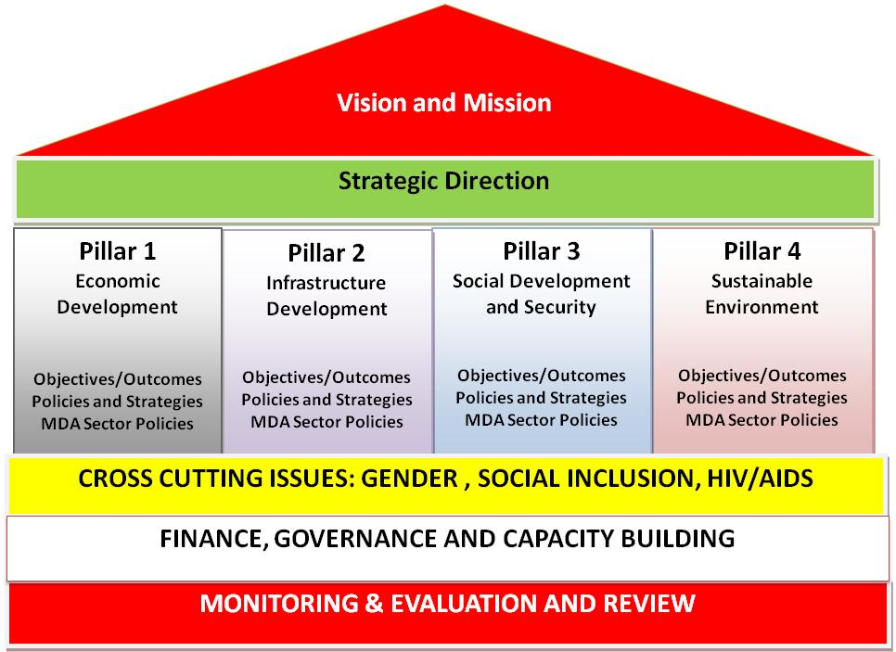
Lagos State SDP Framework
Source: Reflections on Lagos State Development Plan

Slide 33
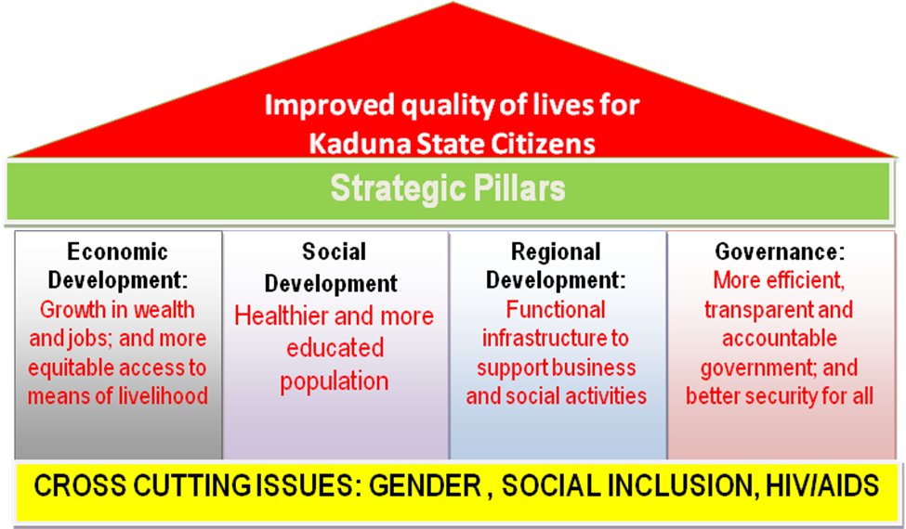
Kaduna State Development Goals
Source: Draft KSDP 2014 -2018 Aand Agric Sector Plan 27th August 2013 (SPARC)

Slide 34
Ondo State Development Plan Pillars and Goals
To be the best
administered state in Nigeria where the economy is well diversified and resources are well harnessed for the socio-economic well-being and security of the people
To be a State where Transparency, Accountability and Equity are the driving forces [hallmark] of Governmental actions
To be a State where every citizen have access to all social amenities on equitable basis in order to achieve self-worth and human dignity in a secured environment
To provide an effective and efficient basic social and physical infrastructure that would support economic development in a sustainable manner
To diversify the state’s economy by harnessing various resources (both Natural and Human) for social economic well-being of the citizenry
GOVERNANCE
SOCIAL DEVELOPMENT
REGIONAL DEVELOPMENT
ECONOMIC DEVELOPMENT
GENDER AND SOCIAL INCLUSION
Source: State Development Plan, 2017 – 2021, Ondo State MEPB

Slide 35
Some FAQs
What is the plan for ensuring continuity?
  Develop and implement a good communication plan
  Ensure every segment of the society is carried along
  From onset, look for champions for the GDS who will be acceptable across political, socio-economic and age divides
  Start implementation immediately, track progress and report back to the people regularly

Slide 36
Some FAQs
Where do you get resources to fund the GDS?
We will not be able to identify where to obtain all the resources needed for implementing a long-term plan at the onset
As we take slices of the plan to implement from year to year:
  the resource base of the nation/state/region improves
  We are able to identify sources of resources more clearly

Slide 37
Thank You

