Slide 1


Strategic Planning: A Panacea for Sustainable Development
Olalekan Yinusa, PhD
Professor of Economics and Development Planning
The Hon. Commissioner,
Ministry of Economic Planning & Budget
State of Osun

Slide 2
Outline of Presentation
The Concept of Planning and Strategic Planning
The Concept of Sustainable Development
  Sustainable Development Goals
Types of Planning
Steps in Strategic Planning Process
A Strategic Planning Model
Difference Between A Strategic Planning and other Planning
Institutional Framework for Strategic Planning
Qualities of A Good Planner
The Importance of Strategic Planning
Challenges of Strategic Planning
Case of State of Osun (State Development Plan)
Key Conclusions

Slide 3
The Concept of Planning & Strategic Planning
Planning is defined as the process of deciding what objectives will be pursued within a future time frame. and what will be done in order to achieve those objectives.
Strategic planning is a systematic process of envisioning a desired future, and translating this vision into broadly defined goals or objectives and a sequence of steps to achieve them.
A strategic plan is a document used to communicate with the organization the organizations goals, the actions needed to achieve those goals and all of the other critical elements developed during the planning exercise.

Slide 4
The Concept of Sustainable Development
Sustainable development is the idea that human societies must live and meet their needs without compromising the ability of future generations to meet their own needs. More specifically, sustainable development is a way of organizing society so that it can exist in the long term.
Sustainable development is also the organizing principle for meeting human development goals, while simultaneously sustaining the ability of natural systems to provide the natural resources and ecosystem services on which the economy and society depend

Slide 5

Sustainable Development Goals (SDGs)
There is no short-cut to achieving these 17 Sustainable Development Goals without proper, adequate and effective Planning

Slide 6
Types of Planning
There are four major types of planning
  Strategic Planning: A strategic plan outlines mission, vision, and high-level goals for some years into the future (relatively long-term). It also takes into account how the goals would be measured, and the identified major projects to achieve the goals.
  Tactical Planning: Tactical Planning is the process of breaking down the strategic plan into distinctive, short or medium term plans
  Operational Planning: An operational plan (also known as a work plan) is a highly detailed outline of what a unit will focus on for the near future
  Contingency Planning: A contingency plan is a plan devised for an outcome other than in the usual (expected) plan

Slide 7
Sequence of Steps in Strategic Planning Process
Strategic Planning involves logical processes which include the following;
  Identify Key Stakeholders
  Identify Strategic Factors for Key Stakeholders
  Access Performance on Strategic Factors
  Set Targets on Strategic Factors
  Develop Strategies to Achieve Targets
  Set Targets on Objectives
  Write Strategic Plan

Slide 8
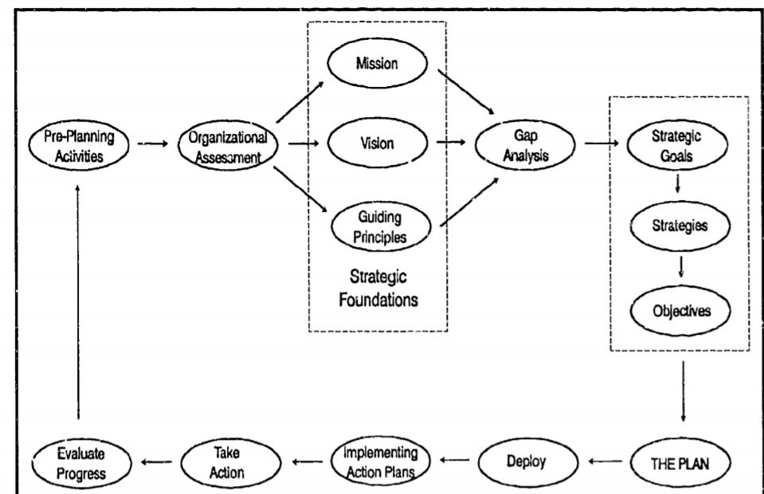
A Strategic Planning Model

Slide 9
Difference Between the Strategic Planning & other Planning
Strategic Planning Other Planning
Effectiveness Efficiency
Top-down Bottom-up / Staff-generated
Creates future Extends present
5- to 20-year horizon 1- to 5-year horizon
Guides management behavior Little or no guidance for management behavior
External customer focus Internal customer focus
Emphasizes the process Emphasizes the plan
Proactive Reactive

Slide 10
Institutional Frameworks for Strategic Planning
Ministry of Economic Planning & Budget takes Lead
Joint Planning Council
Planning Teams (Sector Champions)
The Role of Legislature
Non-Government Actors
  Civil Society Organization (CSO),
  CBO,
  Representatives of Labour Organisations
  Religious Groups,
  Development Associations,
  Representatives of Organised Private Sector
  Development Partners
  Representatives of other Political Parties
Extensive capacity building for all team members
Legislation Vs. Non-Legislation of Plans

Slide 11
Qualities of A Good Planner
Good Planner must possess:
Quantitative and analytical skills
Systems aptitude (ability to interact well with analytical software)
Technical knowledge
Global Perspectives
Clear communication skills
Ownership of every sectoral activities under his/her control

Slide 12
Qualities of A Good Planner
Focus and keep track of activities
Prioritization ability
Sound judgment on issues
Ability to follow-through each activity
Proactive mindset/sense of urgency
Positive attitude
Skills to be a Team Player

Slide 13
The Importance of Strategic Planning
Planning provides a sense of Direction: Planning involves predetermined action plan that states in advance what and how a task will be achieved
Planning reduces Uncertainty: Planning not only sets objectives but also anticipates any future changes
Planning reduces Wastefulness: The detailed plans keep in mind the needs of all the MDAs. This ensures that all the sectors are on the same page about the plan and that all their activities are coordinated.

Slide 14
The Importance of Strategic Planning
Planning invokes Innovation: Planning encourages the leaders to broaden their horizons and forces them to think differently
Makes Decision-Making Easier: planning involves setting goals, developing action plans and making predictions for future events. Decision is thus made with ease
Establishes Standards: Once the planning is done, the leaders/managers now have set goals and standards. This provides the standards against which actual performances could be measured

Slide 15
Challenges of Strategic Planning
  It is a complex process
  It is time consuming
  It is difficult to implement
  It requires skillful Planning
  Planning cannot foresee everything, and thus, there may be obstacles to effective planning
  It may leads to rigidity.
  It may not work in a dynamic environment.

Slide 16
CASE OF STATE OF OSUN
STATE DEVELOPMENT PLAN (SDP)

Slide 17
CASE OF STATE OF OSUN STATE DEVELOPMENT PLAN (SDP)
Envisioning workshop –
  Political Leadership is key!
MTSS Training workshop
MTEF Training workshop
MTSS consolidation workshop
SDP and MTSS Validations Meetings
Comprehensive Media Plan

Slide 18
OUTCOMES OF PUBLIC FINANCIAL MANAGEMENT (PFM) REFORMS IN OSUN STATE
It enhances budget reliability
It reduces budget lobbying
It guarantee effective monitoring and evaluation of development programs and projects
It guarantee transparency and accountability
It ensures inclusiveness and participatory governance

Slide 19
Key Conclusions
The journey of a successful strategic planning process requires the following;
  Strong Political Will and Commitment
  Very focused Leadership in the Ministry of Economic Planning and Budget for Coordination of Strategic Planning Process
  Positive mental and attitudinal posture of planning teams
  The process must be inclusive for sustainability
  Communication must be continuous and ceaseless
  Adequate financial and other resources must be made available

Slide 20
THANK YOU
Olalekan Yinusa, PhD
Professor of Economics & The Honourable Commissioner,
Ministry of Economic Planning & Budget
State of Osun
Email: hc.planning@osun.gov.ng

